Slide 1
Software Engineering
Wei-Min Wu（吴为民）
School of Petroleum
China University of Petroleum - Beijing at Karamay
Fall, 2025

Slide 2
Chap. 3 Agile Software Development
Topics covered
Agile methods 敏捷方法
Agile development techniques 敏捷开发技术
Agile project management 敏捷项目管理
Scaling agile methods 敏捷方法伸缩

Slide 3
Chap. 3 Agile Software Development
Rapid software development 快速软件开发
Rapid development and delivery is now often the most important requirement for software systems
Businesses operate in a fast–changing requirement 需求在快速变化
Software has to evolve quickly to reflect changing business needs. 软件必须快速演化，以满足变化的商业需要
Plan-driven development is essential for some types of system but does not meet these business needs. 计划驱动的方法不满足商业需要
Agile development methods emerged in the late 1990s whose aim was to radically reduce the delivery time. 敏捷开发方法的目的：彻底降低交付时间

Slide 4
Chap. 3 Agile Software Development
Agile development: characteristics 特性
Program specification, design and implementation are inter-leaved. 规格说明、设计、实现相互交织
The system is developed in a series of increments. Stakeholders are involved in specifying and evaluating each increment. 增量式开发，干系人参与
Extensive tool support (e.g. automated testing tools) used to support development. 广泛的工具支持
Minimal documentation – focus on working code. 最小化文档

Slide 5
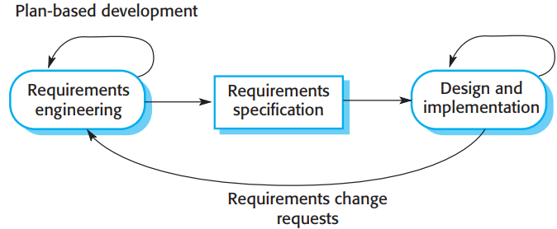
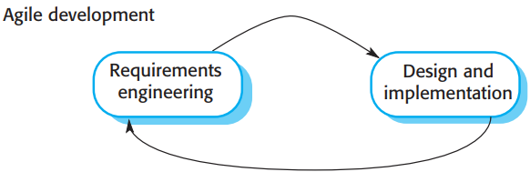
Chap. 3 Agile Software Development
Plan-driven and agile development

Slide 6
Chap. 3 Agile Software Development
Plan-driven and agile development 计划驱动 vs 敏捷开发
Plan-driven development: Iteration occurs within activities, with formal documents used to communicate between stages of the process. 计划驱动开发
Agile development: Iteration occurs across activities. Therefore, the requirements and the design are developed together rather than separately. 敏捷开发
In practice: Plan-driven processes are often used along with agile programming practices, and agile methods may incorporate some planned activities apart from programming and testing. 实际情况

Slide 7
Chap. 3 Agile Software Development
Agile methods 敏捷方法
Dissatisfaction with the overheads involved in software design methods of the 1980s/1990s led to the creation of agile methods. These methods: 背景
Focus on the code rather than the design.
Based on an iterative approach to software development.
Are intended to deliver software quickly and evolve this quickly to meet changing requirements.
The aim of agile methods is to reduce overheads in the software process (e.g. by limiting documentation) and to be able to respond quickly to changing requirements without excessive rework. 目标：降低开销，快速响应变化需求、无过度返工

Slide 8
Chap. 3 Agile Software Development
Agile manifesto 敏捷宣言
Issued by the leading developers of the methods:
We are uncovering better ways of developing software by doing it and helping others do it. Through this work we have come to value:
Individuals and interactions over processes and tools; Working software over comprehensive documentation; Customer collaboration over contract negotiation; Responding to change over following a plan.
That is, while there is value in the items on the right, we value the items on the left more.

Slide 9
Chap. 3 Agile Software Development
The principles of agile methods 原则
Principle | Description 描述
Customer involvement | Customers should be closely involved throughout the development process.Their role is provide and prioritize new system requirements and to evaluate the iterations of the system.
Embrace change | Expect the system requirements to change, and so design the system to accommodate these changes.
Incremental delivery | The software is developed in increments, with the customer specifying the requirements to be included in each increment.
Maintain simplicity | Focus on simplicity in both the software being developed and in the development process. Wherever possible, actively work to eliminate complexity from the system.
People, not process | The skills of the development team should be recognized and exploited. Team members should be left to develop their own ways of working without prescriptive processes.

Slide 10
Chap. 3 Agile Software Development
Agile method applicability 敏捷方法应用
Product development where a software company is developing a small or medium-sized product for sale. 中小规模产品
Virtually all software products and apps are now developed using an agile approach.
Custom system development within an organization, where there is a clear commitment from the customer to become involved in the development process and where there are few external rules and regulations that affect the software. 定制化系统

Slide 11
Chap. 3 Agile Software Development
Agile development techniques 敏捷开发技术
- Extreme programming (XP) 极限编程
A very influential agile method, developed in the late 1990s, that introduced a range of agile development techniques. 极有影响力的敏捷开发方法
The name was coined by Kent Beck because the approach was developed by pushing recognized good practice, such as iterative development, to “extreme” levels. 将最佳实践推动到极端水平
For example, in XP, several new versions of a system may be developed by different programmers, integrated, and tested in a day.

Slide 12
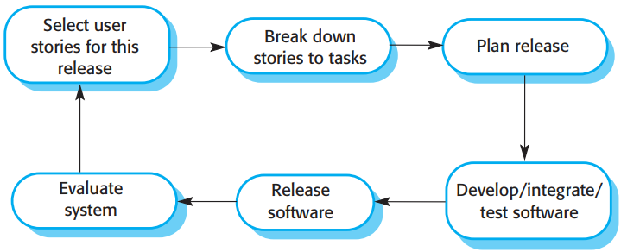
Chap. 3 Agile Software Development
The extreme programming release cycle
• In XP, requirements are expressed as scenarios (called user stories), which are implemented directly as a series of tasks. 场景(用户故事)->任务
• Programmers work in pairs and develop tests for each task before writing the code. All tests must be successfully executed when new code is integrated into the system. 结对工作,写代码前开发测试,集成前完成测试
• There is a short time gap between releases of the system.发行间时间短

Slide 13
Chap. 3 Agile Software Development
Extreme programming practices (a)
Principle or practice | Description 描述
Collective ownership共同拥有权 | The pairs of developers work on all areas of the system, so that no islands of expertise develop and all the developers take responsibility for all of the code. Anyone can change anything.
Continuous integration 持续集成 | As soon as the work on a task is complete, it is integrated into the whole system. After any such integration, all the unit tests in the system must pass.
Incremental planning 增量式规划 | Requirements are recorded on “story cards” and the stories to be included in a release are determined by the time available and their relative priority. The developers break these stories into development “tasks”. See Figures 3.5 and 3.6.
On-site customer 现场客户 | A representative of the end-user of the system (the Customer) should be available full time for the use of the XP team. In an extreme programming process, the customer is a member of the development team and is responsible for bringing system requirements to the team for implementation.

Slide 14
Chap. 3 Agile Software Development
Extreme programming practices (b)
Pair programming 结对编程 | Developers work in pairs, checking each other’s work and providing the support to always do a good job.
Refactoring 重构 | All developers are expected to refactor the code continuously as soon as potential code improvements are found. This keeps the code simple and maintainable.
Simple design 简单设计 | Enough design is carried out to meet the current requirements and no more.
Small releases 小的发布 | The minimal useful set of functionality that provides business value is developed first. Releases of the system are frequent and incrementally add functionality to the first release.
Sustainable pace 可持续步调 | Large amounts of overtime are not considered acceptable as the net effect is often to reduce code quality and medium-term productivity
Test-first development测试先行的开发 | An automated unit test framework is used to write tests for a new piece of functionality before that functionality itself is implemented.

Slide 15
Chap. 3 Agile Software Development
XP and agile principles (of manifesto)
Incremental development is supported through small, frequent system releases. 增量式开发
Customer involvement is supported through continuous engagement with the team. 客户持续参与
People, not process, are supported through pair programming, collective ownership of code, and a sustainable development process that avoids excessive long working hours. 结对编程，共同拥有权，可持续开发
Change is embraced through regular system releases, test first development, refactoring to avoid code degeneration, and continuous integration of new fuctionality. 拥抱变化
Maintaining simplicity by constant refactoring that improves code quality and by using designs that do not unnecessarily anticipate future changes to the system. 保持简单

Slide 16
Chap. 3 Agile Software Development
Influential XP practices XP实践
In practice, the application of XP has proved to be more difficult than anticipated. It cannot be readily integrated with the management practices and culture of most businesses. XP难于应用
So, companies choose those XP practices that are most appropriate for their way of working. 选适合的
Key practices
User stories for specification 规格说明：用户故事
Refactoring 重构
Test-first development 测试先行的开发
Pair programming 结对编程

Slide 17
Chap. 3 Agile Software Development
User stories for requirements 用户故事->需求
In XP, a customer or user is part of the XP team and is responsible for making decisions on requirements. 在XP中，客户是团队组成部分，负责需求决策
User requirements are expressed as user stories or scenarios. 用户需求表达为用户故事或场景
These are written on cards and the development team break them down into implementation tasks. These tasks are the basis of schedule and cost estimates. 写在卡片上,分解为任务->调度,成本评估
The customer chooses the stories for inclusion in the next release based on their priorities and the schedule estimates. 客户选择哪些故事在下一个版本实现

Slide 18

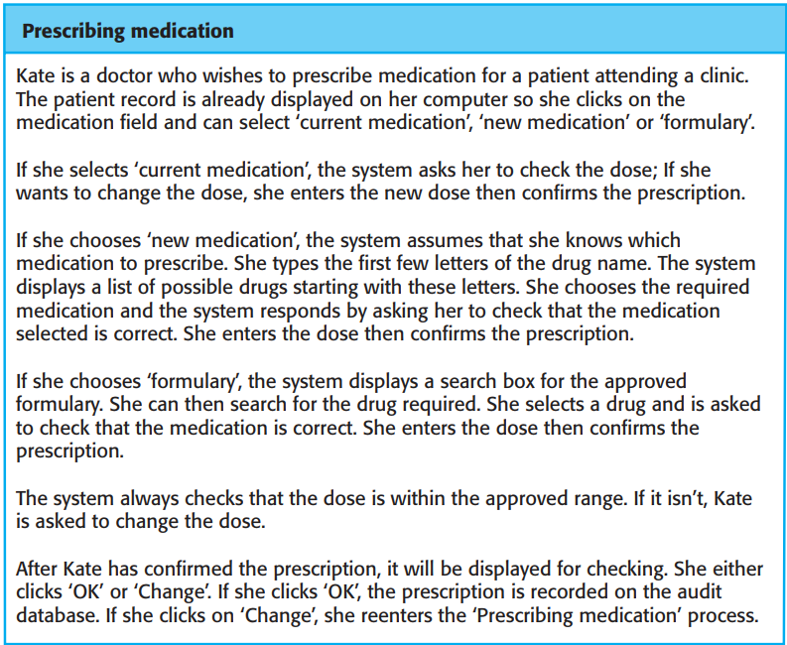
Chap. 3 Agile Software Development
A “prescribing medication” story
• An example of a story card for the Mentcare system is shown in Figure 3.5.
• This is a short description of a scenario for prescribing medication for a patient.

Slide 19
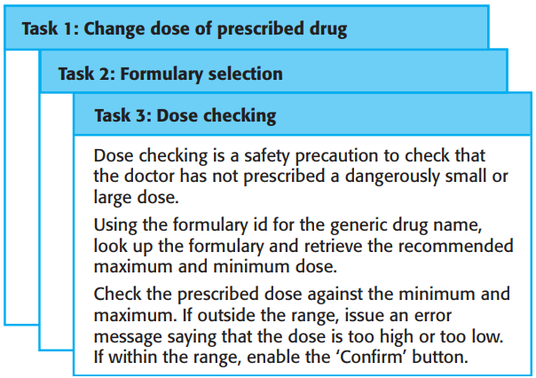
Chap. 3 Agile Software Development
Examples of task cards for prescribing medication
• User stories may be used in planning system iterations.
• Once the story cards have been developed, the development team breaks these down into tasks (Figure 3.6) and estimates the effort and resources required for implementing each task.
修改剂量
处方选择
剂量检查

Slide 20
Chap. 3 Agile Software Development
Refactoring
Conventional wisdom in software engineering is to design for change. It is worth spending time and effort anticipating changes as this reduces costs later in the life cycle. 传统：设计时考虑改变
XP, however, maintains that this is not worthwhile as changes cannot be reliably anticipated. XP：不值得，变化不能可靠地预见
Rather, it proposes constant code improvement (refactoring) to make changes easier when they have to be implemented. 应经常性地改进（重构）代码

Slide 21
Chap. 3 Agile Software Development
Refactoring 重构
Programming team look for possible software improvements and make these improvements even where there is no immediate need for them. 寻找并实施改进，即使并非急需
In incremental development, local changes tend to degrade the software structure. Refactoring improves the software structure and readability and so changes are easier to make. 重构改进了软件结构，更易实施变化
Some changes cannot readily be made by code-level refactoring and require the architecture of the system be modified. 难点:当体系结构需要变化时

Slide 22
Chap. 3 Agile Software Development
Examples of refactoring 重构例子
Re-organization of a class hierarchy to remove duplicate code. 类层次重组，消除重复代码
Tidying up and renaming attributes and methods to make them easier to understand. 整理，重命名属性和方法使易于理解
The replacement of inline code with calls to methods that have been included in a program library. 用方法调用替代内联代码
Program development environments usually include tools for refactoring. 开发环境中通常包含重构工具

Slide 23
Chap. 3 Agile Software Development
Test-first development 测试先行的开发
XP developed a new approach to program testing to address the difficulties of testing without a specification. XP: 无规格说明下的测试
Testing is automated and central to XP. 自动化,核心
In XP, the program is tested after every change has been made. 每做改变后，即做测试
XP testing features: XP测试的特性
Test-first development,
Incremental test development from scenarios,
User involvement in test development and validation,
the use of automated testing frameworks.

Slide 24
Chap. 3 Agile Software Development
Test-driven development 测试驱动的开发
XP’s test-first philosophy has now evolved into more general test-driven development techniques. 更广义
Writing tests before code clarifies the requirements to be implemented. 编写代码前写测试，澄清需求
Tests are written as programs so that they can be executed automatically. The test includes a check that it has executed correctly.测试内含check,可自动运行
Usually relies on a testing framework such as Junit.
All previous and new tests are run automatically when new functionality is added, checking that the new functionality has not introduced errors. 检查错误

Slide 25
Chap. 3 Agile Software Development
Customer involvement 客户参与
The role of the customer in the testing process is to help develop acceptance tests for the stories that are to be implemented. 角色:帮助开发验收测试
The customer who is part of the team writes tests as development proceeds. All new code is therefore validated to ensure that it is what the customer needs. 客户写测试，确认新代码是客户所需
• XP’s test-first approach assumes that user stories have been developed, and these have been broken down into a set of task cards, as shown in Figure 3.6. Each task generates one or more unit tests that check the implementation described in that task.
• Figure 3.7 is a shortened description of a test case that has been developed to check that the prescribed dose of a drug does not fall outside safe limits.

Slide 26
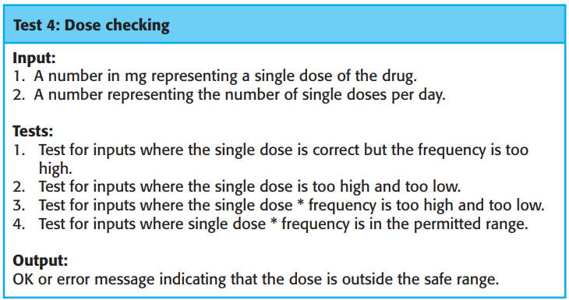
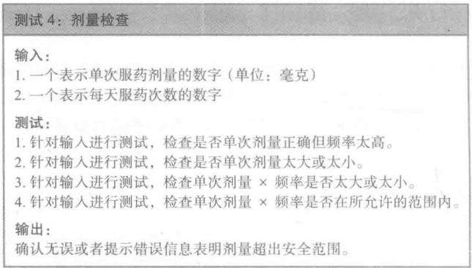
Chap. 3 Agile Software Development
Test case description for dose checking

Slide 27
Chap. 3 Agile Software Development
Test automation 测试自动化
Test automation means that tests are written as executable components before the task is implemented 意思：测试写成可执行组件
These testing components should be stand-alone, should simulate the submission of input to be tested and should check that the result meets the output specification.
An automated test framework (e.g. Junit) is a system that makes it easy to write executable tests and submit a set of tests for execution.
Whenever any functionality is added to the system, the tests can be run and problems that the new code has introduced can be caught immediately.

Slide 28
Chap. 3 Agile Software Development
Problems with test-first development 问题
Programmers prefer programming to testing and sometimes they take short cuts when writing tests. For example, they may write incomplete tests that do not check for all possible exceptions. 走捷径,不完备
Some tests can be very difficult to write incrementally. For example, in a complex user interface, it is often difficult to write unit tests for the code that implements the “display logic” and workflow between screens. 增量式写测试会很困难
It difficult to judge the completeness of a set of tests. Your test set may not provide complete coverage. 判断一组测试的完备性是困难的

Slide 29
Chap. 3 Agile Software Development
Pair programming 结对编程
Programmers work in pairs to develop code. The programming pair sits at the same computer to develop the software. 结对、坐在同一台电脑前开发
However, the same pair do not always program together. Rather, pairs are created dynamically so that all team members work with each other during the development process. 动态结对
Many companies are suspicious of pair programming and do not use it. Other companies mix pair and individual programming, experienced + less experienced colleague when they have problems. 怀疑，混合
Formal studies of the value of pair programming have had mixed results. 正式研究有不同结果

Slide 30
Chap. 3 Agile Software Development
Pair programming-advantages
It supports the idea of collective ownership and responsibility for the system. 共同拥有，共同责任
It acts as an informal review process because each line of code is looked at by at least two people. It is cheaper and easier to organize than formal program inspections 充当非正式评审
It encourages refactoring to improve the software structure. Others benefit immediately from the refactoring so they are likely to support the process. 鼓励重构

Slide 31
Chap. 3 Agile Software Development
Agile project management 敏捷项目管理
The principal responsibility of software project managers is to manage the project so that the software is delivered on time and within the planned budget for the project. 项目经理的责任：按时交付，预算之内
The standard approach to project management is plan-driven. Managers draw up a plan for the project showing what should be delivered, when it should be delivered and who will work on the development of the project deliverables. 标准方法:计划驱动的项目管理
Agile project management requires a different approach, which is adapted to incremental development and the practices used in agile methods. 敏捷项目管理需要不同方法:适应增量式开发和敏捷方法实践

Slide 32
Chap. 3 Agile Software Development
Scrum origin Scrum起源
Agile development has to be managed so that the best use is made of the time and resources available to the team. 敏捷项目需要管理
For this, Scrum agile method was developed to provide a framework for organizing agile projects and, to some extent, provide external visibility of what is going on. 为此,开发Scrum敏捷方法,提供组织框架
The developers of Scrum wished to make clear that Scrum was not a method for project management, so they deliberately invented new terminology, such as ScrumMaster, which replaced project manager. Scrum不是项目管理方法

Slide 33
Chap. 3 Agile Software Development
Scrum terminology (a) Scrum术语
Scrum term | Definition
Development team开发团队 | A self-organizing group of software developers, which should be no more than 7 people. They are responsible for developing the software and other essential project documents.
Potentially shippable product increment | The software increment that is delivered from a sprint. The idea is that this should be “potentially shippable” which means that it is in a finished state and no further work, such as testing, is needed to incorporate it into the final product. In practice, this is not always achievable.
Product backlog 产品待办事项 | This is a list of “to do” items which the Scrum team must tackle. They may be feature definitions for the software, software requirements, user stories or descriptions of supplementary tasks that are needed, such as architecture definition or user documentation.
Product owner 产品拥有者 | An individual (or possibly a small group) whose job is to identify product features or requirements, prioritize these for development and continuously review the product backlog to ensure that the project continues to meet critical business needs. The Product Owner can be a customer but might also be a product manager in a software company or other stakeholder representative.

Slide 34
Chap. 3 Agile Software Development
Scrum terminology (b)
Scrum term | Definition
Scrum 每日站立会议 | A daily meeting of the Scrum team that reviews progress and prioritizes work to be done that day. Ideally, this should be a short face-to-face meeting that includes the whole team.
ScrumMaster Scrum主管 | The ScrumMaster is responsible for ensuring that the Scrum process is followed and guides the team in the effective use of Scrum. He or she is responsible for interfacing with the rest of the company and for ensuring that the Scrum team is not diverted by outside interference. The Scrum developers are adamant that the ScrumMaster should not be thought of as a project manager. Others, however, may not always find it easy to see the difference.
Sprint 冲刺 | A development iteration. Sprints are usually 2-4 weeks long.
Velocity 速度 | An estimate of how much product backlog effort that a team can cover in a single sprint. Understanding a team’s velocity helps them estimate what can be covered in a sprint and provides a basis for measuring improving performance.

Slide 35
Chap. 3 Agile Software Development
Scrum
Scrum is an agile method insofar as it follows the principles from the agile manifesto. Scrum是敏捷方法
It focuses on providing a framework for agile project organization, and it does not mandate the use of specific development practices.关注提供框架
This means that it can be more easily integrated with existing practice. 易于与现有实践集成
Consequently, as agile methods have become a mainstream approach to software development, Scrum has emerged as the most widely used method. 敏捷方法成为主流 -> Scrum最广泛使用

Slide 36
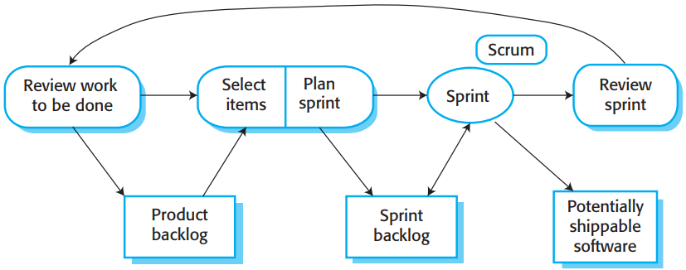
Chap. 3 Agile Software Development
Scrum sprint cycle
• The Scrum process or sprint cycle is shown in Figure 3.9.
• The input to the process is the product backlog. Each process iteration produces a product increment that could be delivered to customers.

Slide 37
Chap. 3 Agile Software Development
The Scrum sprint cycle
The starting point for the Scrum sprint cycle is the product backlog, which is the list of work to be done on the project. 起点
Each sprint cycle lasts a fixed length of time, which is usually between 2 and 4 weeks. 持续时间
The Product Owner prioritizes the items on the product backlog to define which are the most important items to be developed. 确定优先权
The whole team then select which of the highest priority items can be completed. They then estimate the time required to complete these items. This leads to the creation of a sprint backlog. 选择

Slide 38
Chap. 3 Agile Software Development
The Sprint cycle
The team self-organizes to decide who will work on what, and the sprint begins. 冲刺开始
During the sprint, the team holds short daily meetings (Scrums) to review progress and, where necessary, to re-prioritize work. There is no top-down direction from the ScrumMaster. The daily interactions among Scrum teams may be coordinated using a Scrum board. 每天简短会议
At the end of each sprint, there is a review meeting, which involves the whole team. The work done is reviewed and presented to stakeholders. The next sprint cycle then begins. 最后，全团队评审会，交付

Slide 39
Chap. 3 Agile Software Development
Teamwork in Scrum 团队合作
The “Scrum master” is a facilitator who arranges daily meetings, tracks the backlog of work to be done, records decisions, measures progress against the backlog and communicates with stackholders outside of the team. Scrum主管的作用
The whole team attends short daily meetings (Scrums) where all team members share information, describe their progress since the last meeting, problems that have arisen and what is planned for the following day. 团队交流
This means that everyone on the team knows what is going on and, if problems arise, can re-plan short-term work to cope with them.

Slide 40
Chap. 3 Agile Software Development
Scrum benefits Scrum益处
The product is broken down into a set of manageable and understandable chunks. 产品分解为可管理、可理解的块
Unstable requirements do not hold up progress. 不稳定需求不会阻碍进度
The whole team has visibility of everything, and consequently team communication and morale are improved. 提升团队沟通和士气
Customers see on-time delivery of increments and gain feedback on how the product works. 按时交付
Trust between customers and developers is established, and a positive culture is created in which everyone expects the project to succeed. 信任+积极文化

Slide 41
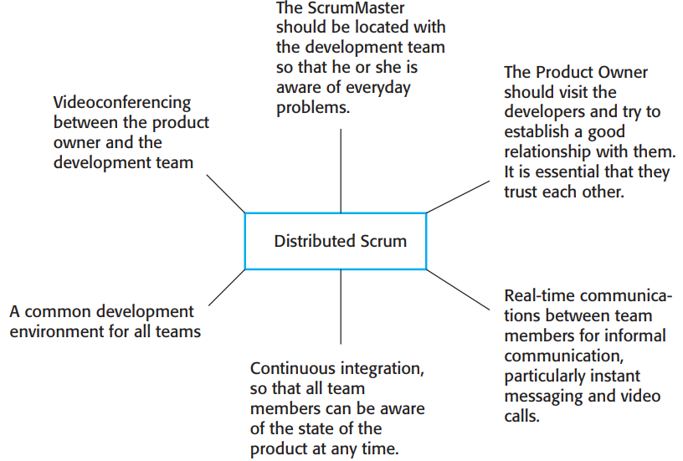
Chap. 3 Agile Software Development
Distributed Scrum 分布式Scrum
• There have been developments of Scrum for distributed development environments and multi-team working.
• Typically, for offshore development, the product owner is in a different country from the development team, which may also be distributed.
• Figure 3.10 shows the requirements for Distributed Scrum.

Slide 42
Chap. 3 Agile Software Development
Scaling agile methods 敏捷方法伸缩
Agile methods have proved to be successful for small and medium sized projects that can be developed by a small co-located team. 适用于小、中产品
Of course, the need for faster delivery of software, which is more suited to customer needs, also applies to both larger systems and larger companies. 大系统、大公司也有快速交付的需要
Scaling up agile methods involves changing these to cope with larger, longer projects where there are multiple development teams, perhaps working in different locations. 敏捷方法伸缩所涉及事项

Slide 43
Chap. 3 Agile Software Development
Scaling up and scaling out 伸缩的两方面
“Scaling up” these methods to handle the development of large systems that are too big to be developed by a single small team. 纵向伸缩
“Scaling out” these methods from specialized development teams to more widespread use in a large company that has many years of software development experience. 横向伸缩
Of course, scaling up and scaling out are closely related. 两者紧密关联

Slide 44
Chap. 3 Agile Software Development
Practical problems with agile methods 实际问题
The informality of agile development is incompatible with the legal approach to contract definition that is commonly used in large companies. 不正式，与合同定义的合法途径不相容
Agile methods are most appropriate for new software development rather than for software maintenance. Yet the majority of software costs in large companies come from maintaining their existing software systems. 最适合新软件开发，不适合软件维护
Agile methods are designed for small co-located teams, yet much software development now involves worldwide distributed teams. 只适于小、同地团队

Slide 45
Chap. 3 Agile Software Development
Contractual issues 合同问题
Most software contracts for custom systems are based on a requirements document between the customer and the supplier 合同基于需求文档
Because the interleaved development of requirements and code is fundamental to agile methods, there is no definitive statement of requirements that can be included in the contract. 但在敏捷方法中，合同中无法包含明确的需求说明。
Consequently, agile methods have to rely on contracts in which the customer pays for the time required for system development rather than the development of a specific set of requirements. 故在合同中,客户为系统开发时间,而不是为特定需求开发付费

Slide 46
Chap. 3 Agile Software Development
Agile methods and software maintenance
Most organizations spend more on maintaining existing software than they do on new software development. So, if agile methods are to be successful, they have to support maintenance as well as original development. 敏捷方法应该支持维护
Two key issues: 两个关键问题
Are systems that are developed using an agile approach maintainable, given the emphasis in the development process of minimizing formal documentation? 强调最小化文档情况下，敏捷方法开发的系统可维护吗？
Can agile methods be used effectively for evolving a system in response to customer change requests? 为响应客户变更请求，敏捷方法可有效用于系统演化吗？

Slide 47
Chap. 3 Agile Software Development
Agile maintenance 敏捷维护
Key problems are: 关键问题
Lack of product documentation: many agile methods collect requirements informally and incrementally and do not create a coherent requirements document. These may therefore make subsequent system maintenance more difficult and expensive. 缺产品文档
Keeping customers involved：while a customer may justify the full-time involvement during system development, this is less likely during maintenance. Customer representatives are likely to lose interest. 保持客户参与
Development team continuity：if an agile development team is broken up, then it is difficult for new team members to build up the same understanding of the system and its components. 开发团队的延续性

Slide 48
Chap. 3 Agile Software Development
Agile principles and organizational practice
The principles underlying agile methods are sometimes difficult to realize in practice.
Principle | Practice
Customer involvement客户参与 | This depends on having a customer who is willing and able to spend time with the development team and who can represent all system stakeholders. Often, customer representatives have other demands on their time and cannot play a full part in the software development. Where there are external stakeholders, such as regulators, it is difficult to represent their views to the agile team.
Embrace change 拥抱变化 | Prioritizing changes can be extremely difficult, especially in systems for which there are many stakeholders. Typically, each stakeholder gives different priorities to different changes.

Slide 49
Chap. 3 Agile Software Development
Agile principles and organizational practice
Principle | Practice
Incremental delivery 增量式交付 | Rapid iterations and short-term planning for development does not always fit in with the longer-term planning cycles of business planning and marketing. Marketing managers may need to know what product features several months in advance to prepare an effective marketing campaign.
Maintain simplicity 保持简单 | Under pressure from delivery schedules, team members may not have time to carry out desirable system simplifications.
People, not process 人,而不是过程 | Individual team members may not have suitable personalities for the intense involvement that is typical of agile methods, and therefore may not interact well with other team members.

Slide 50
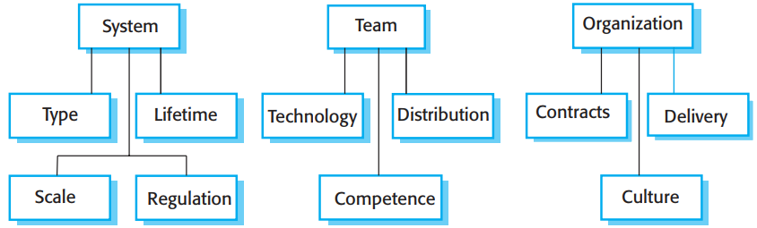
Chap. 3 Agile Software Development
Factors for the choice of plan-based or agile
• Most large “agile” software development projects combine practices from plan-driven and agile approaches. Some are mostly agile, and others are mostly plan-driven but with some agile practices. 两者结合
• To decide on the balance between a plan-based and an agile approach, you have to answer a range of technical, human and organizational questions. These relate to the system being developed, the development team, and the organizations that are developing and procuring the system (Figure 3.12). 3因素：系统、团队、组织

Slide 51
Chap. 3 Agile Software Development
System issues 系统问题
How large is the system being developed? Agile methods are most effective when the system is developed with a small co-located team. For large systems that require larger teams, plan-driven approach have to be used. 系统大小
What type of system is being developed? For systems that require a lot of analysis before implementation and thus need detailed design, a plan-driven approach is best. 系统类型
What is the expected system lifetime? Long-lifetime systems require more documentation. However, supporters of agile methods argue that documentation is frequently not kept up to date and is not of much use for maintenance. 生命周期
Is the system subject to external regulation? If a system has to be approved by an external regulator, then you will probably be required to produce detailed documentation as part of the system safety case. 外部管制

Slide 52
Chap. 3 Agile Software Development
People and teams 个人和团队
How good are the designers and programmers in the development team? 设计者和编程者怎么样？
It is sometimes argued that agile methods require higher skill levels than plan-based approaches in which programmers simply translate a detailed design into code. 敏捷方法需要更高级技能
How is the development team organized?团队如何组织
Design documents may be required if the team is dsitributed.
What support technologies are available? 支持技术
Agile methods often rely on good tools to keep track of an evolving design.

Slide 53
Chap. 3 Agile Software Development
Management issues 管理问题
Is it important to have a detailed specification and design before moving to implementation? If so, you need to use a plan-driven approach for requirements engineering but may use agile development practices during system implementation. 是否先有详细规格说明，然后实现
Is an incremental delivery strategy realistic? Will customer representatives are willing to participate in the development team? 是否增量式交付,客户是否愿意参加团队
Are there cultural issues that may affect system development? Traditional engineering organizations have a culture of plan-based development, this usually requires extensive design documentation rather than the informal knowledge used in agile processes. 是否有文化问题

Slide 54
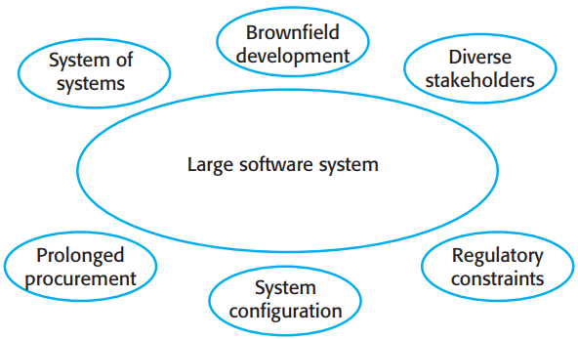

Chap. 3 Agile Software Development
Agile methods for large systems
• Agile methods have to evolve to be used for large-scale software development. The fundamental reason for this is that large-scale software systems are much more complex and difficult to understand and manage. 敏捷方法必须进化，以用于大规模软件开发
• Six principal factors (Figure 3.13) contribute to this complexity.

Slide 55
Chap. 3 Agile Software Development
Six factors that contribute to complexity
Large systems are usually systems of systems—collections of separate, communicating systems, where separate teams develop each system. Often, these teams work in different places, sometimes in different time zones. 系统之系统
Large systems are brownfield systems; that is, they include and interact with a number of existing systems. Many of the requirements are concerned with the interaction and don’t lend themselves to flexibility and incremental development. 棕地系统
Where several systems are integrated to create a system, a significant fraction of the development is concerned with system configuration rather than original code development. 集成的系统

Slide 56
Chap. 3 Agile Software Development
Six factors that contribute to complexity cont’d
Large systems and their development processes are often constrained by external rules and regulations limiting the way that they can be developed. 受限
Large systems have a long procurement and development time. It is difficult to maintain coherent teams who know about the system over that period. 连贯团队
Large systems usually have a diverse set of stakeholders with different perspectives and objectives. It is practically impossible to involve all of these different stakeholders in the development process. 不同干系人

Slide 57
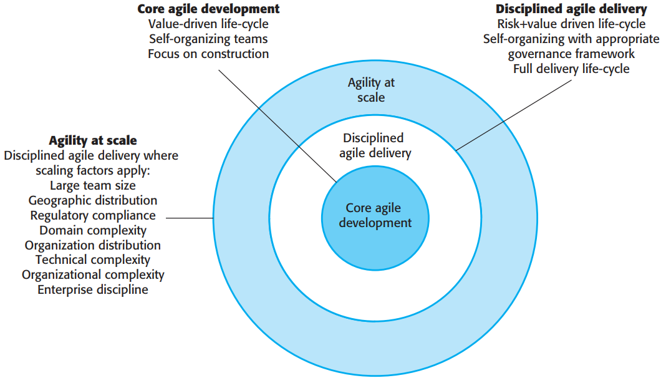
Chap. 3 Agile Software Development
IBM’s agility at scale model
• IBM has developed a framework for the large-scale use of agile methods called the Agile Scaling Model (ASM).

Slide 58
Chap. 3 Agile Software Development
Things in common for scaling agile methods 敏捷方法伸缩的共同点
A completely incremental approach to requirements engineering is impossible. 完全增量式不可能
There cannot be a single product owner or customer representative, they have to communicate and negotiate throughout. 不止一个产品负责人或客户代表
It is not possible to focus only on the code. You need to do more up-front design and system documentation. 不能只关注代码，还要做前期设计和文档
Cross-team communication mechanisms have to be designed and used. 建立和利用跨团队的沟通机制
Continuous integration is impossible when several separate programs have to be integrated to create the system. But it is essential to maintain frequent system builds and regular releases. 持续集成不可能, 频繁构建+定期发布

Slide 59
Chap. 3 Agile Software Development
Key characteristics of multi-team Scrum 多团队Scrum的关键特性
Role replication: Each team has a Product Owner and ScrumMaster. There may be a chief Product Owner and ScrumMaster for the entire project. 角色重复
Product architects: Each team chooses a product architect, and these architects collaborate to design and evolve the overall system architecture. 产品架构师
Release alignment: The dates of product releases from each team are aligned so that a demonstrable and complete system is produced. 发布同步
Scrum of Scrums: There is a daily Scrum of Scrums where representatives from each team meet to discuss progress, identify problems, and plan the work to be done that day. 每日站立会议

Slide 60
Chap. 3 Agile Software Development
Difficulties to introduce agile methods into large companies 大公司引入敏捷方法的困难
Project managers who do not have experience of agile methods may be reluctant to accept the risk of a new approach. 项目经理没经验，不愿冒险
Large organizations have quality procedures and standards that all projects are expected to follow, and, because of the bureaucratic nature, these are likely to be incompatible with agile methods. 官僚本性，与敏捷方法不相容
Agile methods seem to work best when team members have a relatively high skill level. However, within large organizations, there are likely to be a wide range of skills and abilities. 团队成员技能不一
There may be cultural resistance to agile methods, especially in organizations that have a long history of using conventional systems engineering processes. 文化抵触

Slide 61
Chap. 3 Agile Software Development
Key points
Agile methods are incremental development methods that focus on rapid software development, frequent releases of the software, reducing process overheads by minimizing documentation and producing high-quality code.
Agile development practices include
User stories for system specification
Frequent releases of the software,
Continuous software improvement
Test-first development
Customer participation in the development team.

Slide 62
Chap. 3 Agile Software Development
Key points
Scrum is an agile method that provides a project management framework.
It is centred round a set of sprints, which are fixed time periods when a system increment is developed.
Many practical development methods are a mixture of plan-based and agile development.
Scaling agile methods for large systems is difficult.
Large systems need up-front design and some documentation and organizational practice may conflict with the informality of agile approaches.

